Slide 1
CSE331
Automata and computability
Turing machines: encoding, proving decidability, proving undecidability
Summer 2026

Slide 2
Today's learning goals Sipser 3.1,3.2
State and use the Church-Turing thesis.
Explain what it means for a problem to be decidable.
Justify the use of encoding.
Give examples of decidable problems.
Use counting arguments to prove the existence of unrecognizable (undecidable) languages.
Use diagonalization in a proof of undecidability.

Slide 3
Review
What's L(M)?
Is M a decider?
Consider the TM M = "On input w,
Run M₁ on w. If M₁ rejects, rejects. If M₁ accepts, go to 2.
Run M₂ on w. If M₂ accepts, accept. If M₂ rejects, reject."
What kind of construction is this?
Formal definition of TM
Implementation-level description of TM
High-level description of TM
I don't know.

Slide 4
Describing TMs Sipser Section 3.3, p. 184
Formal definition: set of states, input alphabet, tape alphabet, transition function, state state, accept state, reject state.
Implementation-level definition: English prose to describe Turing machine head movements relative to contents of tape.
High-level description: Description of algorithm, without implementation details of machine. As part of this description, can "call" and run another TM as a subroutine.

Slide 5
Subroutines
Consider the TM M = "On input w,
Run M₁ on w. If M₁ rejects, rejects. If M₁ accepts, go to 2.
Run M₂ on w. If M₂ accepts, accept. If M₂ rejects, reject."

Slide 6
High-level description = Algorithm
Wikipedia "self-contained step-by-step set of operations to be performed"
"An algorithm is a finite sequence of precise instructions for performing a computation or for solving a problem."
Each algorithm can be implemented by some Turing machine.
Church-Turing thesis

Slide 7
At start of CSE 331…
Classification: is input of type A or not?
Decision problem
{ w | w is of type A}
PRIME = { 2, 3, 5, 7, … }
SORTED = { <1,3>, <-1, 8, 17> …}
Decision problems are coded by sets of strings
Pick a model of computation
Study what problems it can solve
Prove its limits

Slide 8
Encoding input for TMs Sipser p. 159
By definition, TM inputs are strings
To define TM M:
    "On input w …
    ..
    ..
    …
For inputs that aren't strings,
we have to encode the object
(represent it as a string) first
Notation:
<O> is the string that represents (encodes) the object O
<O₁, …, O_{n}> is the single string that represents the tuple of objects O₁, …, O_{n}

Slide 9
Encoding inputs
Payoff: problems we care about can be reframed as languages of strings
e.g. "Recognize whether a string is a palindrome."
{ w | w in {0,1}* and w = w^{R} }
e.g. "Check whether a string is accepted by a DFA."
{ <B,w> | B is a DFA over Σ, w in Σ*, and w is in L(B) }
e.g. "Check whether the language of a PDA is infinite."
{ <A> | A is a PDA and L(A) is infinite}

Slide 10
Example: encoding a DFA
Think of encoding as a text file that encodes your data
(in some format), that then you store in binary

Slide 11
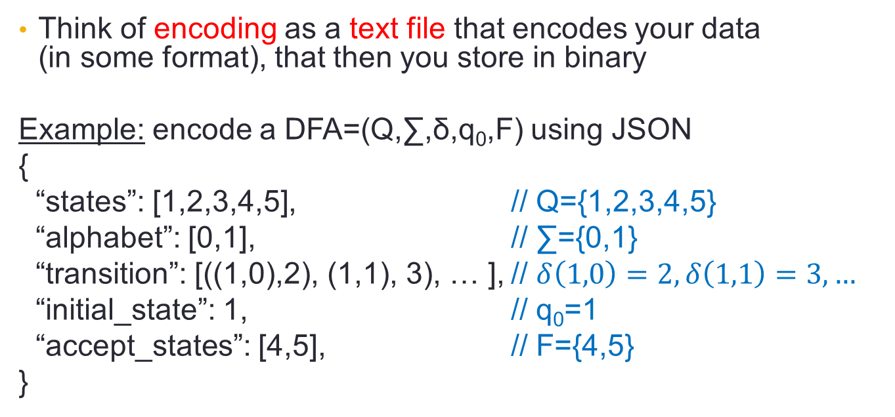
Example: encoding a DFA
Think of encoding as a text file that encodes your data
(in some format), that then you store in binary
Example: encode a DFA=(Q,∑,δ,q₀,F) using JSON
{
“states”: [1,2,3,4,5], // Q={1,2,3,4,5}
“alphabet”: [0,1], // ∑={0,1}
“transition”: [((1,0),2), (1,1), 3), … ], // $δ\left(1,0\right)=2,δ\left(1,1\right)=3,…$
“initial_state”: 1, // q₀=1
“accept_states”: [4,5], // F={4,5}
}

Slide 12
Computational problems
A computational problem is decidable iff the language encoding the problem instances is decidable

Slide 13
Computational problems
Sample computational problems and their encodings:
A_{DFA} "Check whether a string is accepted by a DFA."
{ <B,w> | B is a DFA over Σ, w in Σ*, and w is in L(B) }
E_{DFA} "Check whether the language of a DFA is empty."
{ <A> | A is a DFA over Σ, L(A) is empty }
EQ_{DFA} "Check whether the languages of two DFAs are equal."
{ <A, B> | A and B are DFAs over Σ, L(A) = L(B)}
FACT: all of these problems are decidable!

Slide 14
Proving decidability
Claim: A_{DFA} is decidable
Proof: WTS that { <B,w> | B is a DFA over Σ, w in Σ*, and w is in L(B) } is decidable.
Step 1: construction
How would you check if w is in L(B)?

Slide 15
Proving decidability
Define TM M₁ by: M₁ = "On input <B,w>
Check whether B is a valid encoding of a DFA and w is a valid input for B. If not, reject.
Simulate running B on w (by keeping track of states in B, transition function of B, etc.)
When the simulation ends, by finishing to process all of w, check current state of B: if it is final, accept; if it is not, reject."

Slide 16
Proving decidability
Step 1: construction
Define TM M₁ by M₁ = "On input <B,w>
Check whether B is a valid encoding of a DFA and w is a valid input for B. If not, reject.
Simulate running B on w (by keeping track of states in B, transition function of B, etc.)
When the simulation ends, by finishing to process all of w, check current state of B: if it is final, accept; if it is not, reject."
Step 2: correctness proof
WTS (1) L(M₁) = A_{DFA} and (2) M₁ is a decider.

Slide 17
Proving decidability
Claim: E_{DFA} is decidable
Proof: WTS that { <A> | A is a DFA over Σ, L(A) is empty } is decidable.

Slide 18
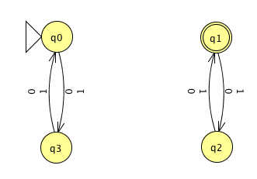
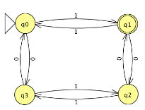
Proving decidability
Claim: E_{DFA} is decidable
Proof: WTS that { <A> | A is a DFA over Σ, L(A) is empty } is decidable.
should accept
should reject

Slide 19
Proving decidability
Claim: E_{DFA} is decidable
Proof: WTS that { <A> | A is a DFA over Σ, L(A) is empty } is decidable.
e.g.< > is in E_{DFA} ; < > is not in E_{DFA}
should accept
should reject

Slide 20
Proving decidability
Claim: E_{DFA} is decidable
Proof: WTS that { <A> | A is a DFA over Σ, L(A) is empty } is decidable. Idea: give high-level description
Step 1: construction
What condition distinguishes between DFA that accept *some* string and those that don't accept *any*?

Slide 21
Proving decidability
Claim: E_{DFA} is decidable
Proof: WTS that { <A> | A is a DFA over Σ, L(A) is empty } is decidable. Idea: give high-level description
Step 1: construction
What condition distinguishes between DFA that accept *some* string and those that don't accept *any*?
Breadth first search in transition diagram to look for path from state state to an accepting state

Slide 22
Proving decidability
Claim: E_{DFA} is decidable
Proof: WTS that { <A> | A is a DFA over Σ, L(A) is empty } is decidable. Idea: give high-level description
Step 1: construction
Define TM M₂ by: M₂ = "On input <A>:
Check whether A is a valid encoding of a DFA; if not, reject.
Mark the start state of A.
Repeat until no new states get marked:
  Loop over states of A and mark any unmarked state that has an incoming edge from a marked state.
If no accept state of A is marked, accept; otherwise, reject.

Slide 23
Proving decidability
Step 1: construction
Define TM M₂ by: M₂ = "On input <A>:
Check whether A is a valid encoding of a DFA; if not, reject.
Mark the state state of A.
Repeat until no new states get marked:
  Loop over states of A and mark any unmarked state that has an incoming edge from a marked state.
If no accept state of A is marked, accept; otherwise, reject.
Step 2: correctness proof
WTS (1) L(M₂) = E_{DFA} and (2) M₂ is a decider.

Slide 24
Techniques Sipser 4.1
Subroutines: can use decision procedures of decidable problems as subroutines in other algorithms
  A_{DFA}
  E_{DFA}
  EQ_{DFA}
Constructions: can use algorithms for constructions as subroutines in other algorithms
  Converting DFA to DFA recognizing complement (or Kleene star).
  Converting two DFA/NFA to one recognizing union (or intersection, concatenation).
  Converting NFA to equivalent DFA.
  Converting regular expression to equivalent NFA.
  Converting DFA to equivalent regular expression.

Slide 25
Computational problems
A computational problem is decidable iff the language encoding the problem instances is decidable

Slide 26
Computational problems
Sample computational problems and their encodings:
A_{DFA} "Check whether a string is accepted by a DFA."
{ <B,w> | B is a DFA over Σ, w in Σ*, and w is in L(B) }
E_{DFA} "Check whether the language of a DFA is empty."
{ <A> | A is a DFA over Σ, L(A) is empty }
EQ_{DFA} "Check whether the languages of two DFAs are equal."
{ <A, B> | A and B are DFA over Σ, L(A) = L(B)}
FACT: all of these problems are decidable!

Slide 27
Computational problems
Sample computational problems and their encodings:
A_{PDA} "Check whether a string is accepted by a PDA."
{ <B,w> | B is a PDA over Σ, w in Σ*, and w is in L(B) }
E_{PDA} "Check whether the language of a PDA is empty."
{ <A> | A is a PDA over Σ, L(A) is empty }
EQ_{PDA} "Check whether the languages of two PDAs are equal."
{ <A, B> | A and B are PDA over Σ, L(A) = L(B)}
FACT: some of these problems are decidable, and some are not!

Slide 28
Computational problems
Sample computational problems and their encodings:
A_{TM} "Check whether a string is accepted by a TM."
{ <B,w> | B is a TM over Σ, w in Σ*, and w is in L(B) }
E_{TM} "Check whether the language of a TM is empty."
{ <A> | A is a TM over Σ, L(A) is empty }
EQ_{TM} "Check whether the languages of two TMs are equal."
{ <A, B> | A and B are TM over Σ, L(A) = L(B)}
FACT: all of these problems are undecidable!

Slide 29
Undecidable?
There are many ways to prove that a problem is decidable.
How do we find (and prove) that a problem is not decidable?

Slide 30
A_{TM}
Recall A_{DFA} = {<B,w> | B is a DFA and w is in L(B) }
Decider for this set simulates arbitrary DFA
A_{TM} = {<M,w> | M is a TM and w is in L(M) }
Decider for this set simulates arbitrary TMs ???

Slide 31
A_{TM}
A_{TM} = {<M,w> | M is a TM and w is in L(M) }
Define the TM N = "On input <M,w>:
Simulate M on w.
If M accepts, accept. If M rejects, reject."

Slide 32
A_{TM}
A_{TM} = {<M,w> | M is a TM and w is in L(M) }
Define the TM N = "On input <M,w>:
Simulate M on w.
If M accepts, accept. If M rejects, reject."
What is L(N)?

Slide 33
A_{TM}
A_{TM} = {<M,w> | M is a TM and w is in L(M) }
Define the TM N = "On input <M,w>:
Simulate M on w.
If M accepts, accept. If M rejects, reject."
Does N decide A_{TM}?

Slide 34
A_{TM}
A_{TM} = {<M,w> | M is a TM and w is in L(M) }
Define the TM N = "On input <M,w>:
Simulate M on w.
If M accepts, accept. If M rejects, reject."
Conclusion: A_{TM} is Turing-recognizable.
Is it decidable?

Slide 35
Diagonalization proof: A_{TM} not decidable Sipser 4.11
Assume, towards a contradiction, that it is.
Call M_{ATM} the decider for A_{TM}:
For every TM M and every string w,
Computation of M_{ATM} on <M,w> halts and accepts if w is in L(M).
Computation of M_{ATM} on <M,w> halts and rejects if w is not in L(M).
M_{ATM} ≠ N

Slide 36
Diagonalization proof: A_{TM} not decidable Sipser 4.11
Assume, towards a contradiction, that M_{ATM} decides A_{TM}
Define the TM D = "On input <M>:
Run M_{ATM} on <M, <M>>.
If M_{ATM} accepts, reject; if M_{ATM} rejects, accept."

Slide 37
Diagonalization proof: A_{TM} not decidable Sipser 4.11
Assume, towards a contradiction, that M_{ATM} decides A_{TM}
Define the TM D = "On input <M>:
Run M_{ATM} on <M, <M>>.
If M_{ATM} accepts, reject; if M_{ATM} rejects, accept."
Consider running D on input <D>. Because D is a decider:
either computation halts and accepts …
or computation halts and rejects …

Slide 38
Diagonalization proof: A_{TM} not decidable Sipser 4.11
Assume, towards a contradiction, that M_{ATM} decides A_{TM}
Define the TM D = "On input <M>:
Run M_{ATM} on <M, <M>>.
If M_{ATM} accepts, reject; if M_{ATM} rejects, accept."
If D(<D>) accepts, then M_{ATM}(<D>,<D>) rejects, which means D(<D>) should have rejected
If D(<D>) rejects, then M_{ATM}(<D>,<D>) accepts, which means D(<D>) should have accepted
Either way, we reached a contradiction

Slide 39
Diagonalization proof: A_{TM} not decidable Sipser 4.11
Diagonalization???
Self-reference
"Is <D> an element of L(D)?"
Assume, towards a contradiction, that M_{ATM} decides A_{TM}
Define the TM D = "On input <M>:
Run M_{ATM} on <M, <M>>.
If M_{ATM} accepts, reject; if M_{ATM} rejects, accept."
Consider running D on input <D>. Because D is a decider:
either computation halts and accepts …
or computation halts and rejects …

Slide 40
Why is this called diagonalization?
Let M₁, M₂, … be an enumeration of all TMs
Let w₁, w₂, … be an enumeration of all inputs
Construct table: $T\left[i,j\right]=\left\{\begin{matrix}1 & if M_{i}\left(w_{j}\right) accepts \\ 0 & otherwise\end{matrix}\right.$
 | w₁ | w₂ | w₃ | …
M₁ | 0 | 0 | 1
M₂ | 1 | 0 | 1
M₃ | 0 | 0 | 1
…

Slide 41
Why is this called diagonalization?
 | w₁ | w₂ | w₃ | …
M₁ | 0 | 0 | 1
M₂ | 1 | 0 | 1
M₃ | 0 | 0 | 1
…
Rows of table describe all recognizable languages
Any other row (=language) cannot be recognizable
We will construct such a language

Slide 42
Why is this called diagonalization?
Next idea: specialize only to inputs <M_{i}>
Suffices to construct row (=language) that differs from any row on some of these inputs
 | <M₁> | <M₂> | <M₃> | …
M₁ | 0 | 0 | 1
M₂ | 1 | 0 | 1
M₃ | 0 | 0 | 1
…

Slide 43
Why is this called diagonalization?
Consider the diagonal: running M_{i} on <M_{i}>; then flip it
L = {<M>: M doesn’t accept <M>}
L cannot be recognized by any M_{i} – they disagree on input <M_{i}>
Since we consider all TMs, L must be un-recognizable
 | <M₁> | <M₂> | <M₃> | …
M₁ | 0 | 0 | 1
M₂ | 1 | 0 | 1
M₃ | 0 | 0 | 1
…

Slide 44
Another perspective
Define language: L = {<M>: M doesn’t accept <M>}
Assume towards a contradiction some TM M decides L
There are two options:
If <M> in L, then M(<M>) accepts, but then <M> not in L
If <M> not in L, then M(<M>) rejects, but then <M> in L
Conclusion: no TM can decide L

Slide 45
A_{TM}
Recognizable
Not decidable
Fact: A language is decidable iff it and its complement are both recgonizable.
Corollary: The complement of A_{TM} is unrecognizable
A_{TM}^{C}= {<M,w> | M is a TM and w is not in L(M) }

